Slide 1
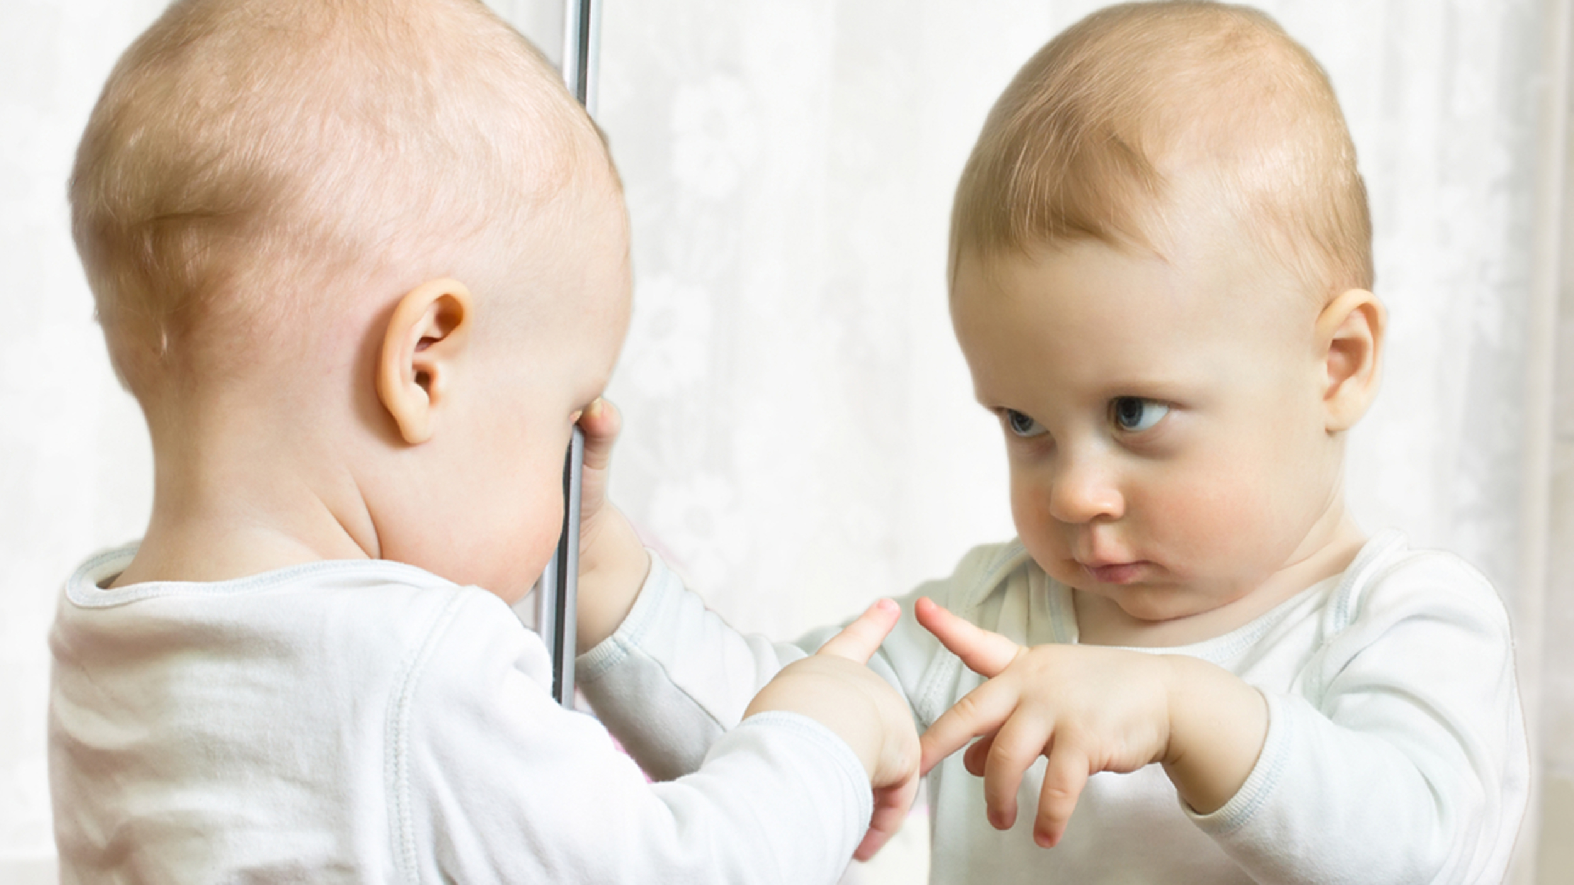
Talking to Yourself
October 16, 2022
© 2019 Rev. Bob Highlands III
Notes:
Originally preached October 6, 2019
There he was again yesterday. Standing on the corner with a sign that said, “VET anything helps.” He was poorly dressed, hair disheveled, ragged beard and he was waving his arms screaming at someone. Who, I might add was not there. He was really mad at this person. Then he walked away and continued to have a conservation with himself. You could see him lean one way and say something and then lean the other and answer. One way he had a stern face. The other he smiled when he was talking. Then, suddenly he turned around and yelled back toward the person who was not there, waving his fist in the air. The light changed and I drove off.
I thought, that was weird, then I spoke outload, Yes, it was. So, if I end up on that corner someday you know it was coming for a long time.
Do you talk to yourself. You know it can be a conservation that goes like this. If I were my cardkeys, where would I be. Aha, I might be in the pants I wore last night and put in the laundry. Or If I were a tube of lip balm where would I be. Well I might have rolled under the couch. I’ll check there.
Again, do you talk to yourself. When I ask that question most honest people say YES. Then I ask, do you answer yourself? The answer is slower, but again most honest people say yes. I did not ask if you hear voices telling you what to do. If that is happening seek professional help right away.
There is One BIG advantage of talking to yourself, You have a captive audience.
There are real advantages to talking to yourself.
“If we speak out loud, it forces us to slow down our thoughts and process them differently because we engage the language centers of our brain.”¹
Did you know “What we say to ourselves, when we say [it], and how, has a tremendous impact on our self-esteem, beliefs about self-efficacy, and overall sense of worth.”¹
¹ https://www.nbcnews.com/better/health/talking-yourself-normal-here-s-how-master-it-ncna918091 accessed October 2, 2019

Slide 2

Benefits of Talking to YOURSELF
Your brain work more efficiently.
Children learn by talking to themselves.
Helps you organize your thoughts.
Helps you achieve your goals.
Helps relieve stress.
Fosters self-reliance.
Notes:
Just a note of clarity. This is not about daydreaming. This is a way of visualizing your goals but is not about you’re your own private paradise where everything goes as you plan.
It is reported that smart people talk to themselves. Albert Einstein talked to himself. He could not comb his hair or tie his shoes but he did talk to himself.
This is not like Gollum in “Lord of the Rings” talking to his PRECIOUS.
People Who Talk To Themselves Aren't Crazy. They’re Actually Geniuses
BY GIGI ENGLE JULY 9, 2015 accessed October 2, 2019, https://www.elitedaily.com/life/culture/people-talk-to-themselves/1105688
6 Benefits of Talking to Yourself (No, You’re Not Crazy)
Matt Duczeminski
https://www.lifehack.org/299684/6-benefits-talking-yourself-youre-not-crazy Accessed October 2, 2019
Your brain work more efficiently. MEMORY & FOCUS
Children learn by talking to themselves. This is why they talk so much. They even repeat everything they hear. It helps them deal with problems.
Helps you organize your thoughts. Important, non-important, large stuff, small stuff. Often when we hear it we realize its real value is low or non-existence. (This only works if emotions are not involved. Anger is a time when we should not talk to ourselves or anyone else as a general rule.
Helps you achieve your goals. Talk through those list you make. It reinforces your memory and keeps you on track.
Helps relieve stress by slowing down and organizing the thought process. Talking to yourself can help “prepare for difficult times in life, such as a conversation with a loved one, colleague, or boss.” (Duczeminski)
Foster self-reliance. WE discover our inner voice and know what we really want.

Slide 3
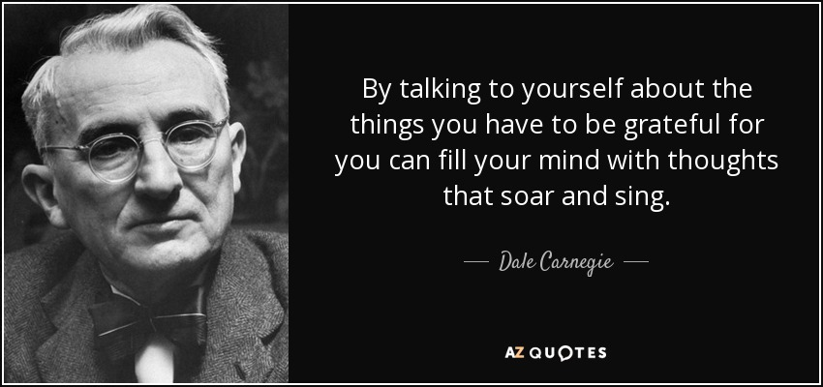
Notes:
Dale Carnegie was an American writer and lecturer and the developer of famous courses in self-improvement, salesmanship, corporate training, public speaking, and interpersonal skills.

Slide 4


Psalm 42.1-11
As the deer pants for streams of water, so my soul pants for you, O God.
My soul thirsts for God, for the living God. When can I go and meet with God?
My tears have been my food day and night, while men say to me all day long, “Where is your God?”.

Slide 5

These things I remember as I pour out my soul: how I used to go with the multitude, leading the procession to the house of God, with shouts of joy and thanksgiving among the festive throng.
Why are you downcast, O my soul? Why so disturbed within me?

Slide 6

Put your hope in God, for I will yet praise him, my Savior and my God. My soul is downcast within me; therefore I will remember you from the land of the Jordan, the heights of Hermon— from Mount Mizar

Slide 7

Deep calls to deep in the roar of your waterfalls; all your waves and breakers have swept over me.
By day the LORD directs his love, at night his song is with me— a prayer to the God of my life.
I say to God my Rock, “Why have you forgotten me? Why must I go about mourning, oppressed by the enemy?”

Slide 8

My bones suffer mortal agony as my foes taunt me, saying to me all day long, “Where is your God?”
Why are you downcast, O my soul? Why so disturbed within me? Put your hope in God, for I will yet praise him, my Savior and my God.

Slide 9

Talking to yourself to get it right.
My soul THIRSTS for God, for the living God.
EFFICIENTLY: This is the natural response to be plugged into God. You think better with God’s help. Talk out loud to God.
These things I REMEMBER as I pour out my soul:
LEARN: I remember when it was different when I was closer to God. I want to Grow & repair my relationship with God.

Slide 10

Talking to yourself to get it right.
Why are you DOWNCAST, O my soul? Why so DISTURBED within me?
ORGANIZE: Asking this question may well be the first step to recovery. *
Put your HOPE in God, for I will yet PRAISE him, my SAVIOR and my God.
ACHIEVE: No matter what is happening God is part of the answer to a successful future.
Notes:
Keep asking the question till you have worked it out.*
What is so important that it interferes with your relationship with God?

Slide 11

Talking to yourself to get it right.
I say to God my Rock, “Why have you FORGOTTEN me?
RELIEVE STRESS: Evaluate what has changed to cause you stress.
Why are you DOWNCAST, O my soul? Why so DISTURBED within me?
SELF-RELIANCE: As a child of God how should you handle this?
Put your hope in God, for I WILL YET praise him, my Savior and my God. *
Jesus is still (always) on His THRONE. He will answer my call. **
Notes:
Remember that your brain is more focused. Imagine how talking out load about God and to God will help you focus on what is MOST important in your life. Keeping the spiritual on track helps all other areas of your life.
Self Reliance is not me alone. It is “I CAN DO ANYTHING WITH GOD’S HELP” It is standing on the rock of CHRIST.
**Sunday is always coming.
Jesus is still on the throne.

Slide 12

Getting Your Spiritual Focus ON
The need to DRINK the water of God.
As the deer pants for streams of water, so my soul pants for you, O God. My soul thirsts for God, for the living God.
The need to DISCOVER God’s presence
My tears have been my food day and night, while men say to me all day long, “Where is your God?”
The need for DIRECTION in your life
Why are you downcast, O my soul? Why so disturbed within me? Put your hope in God, for I will yet praise him, my Savior and my God.
Notes:
Psalm 42 is about spiritual focus.
A spiritual Thirst will drive us panting to God. It takes control and is a primary desire of the Spiritual person.
A spiritual Hunger will force us to seek God. Others cannot find him and wonder if you have. Yet the very tears that bring us to our knees feed us and help us to grow. To HUMBLE, TEACH, TEST and DISCIPLINE our tears are gifts from God when we call on Him for help and guidance.
If you focus on earthly leaders they will fail you. When you get down you need to PUT YOUR HOPE IN GOD. Will you get downcast?

Slide 13

Spiritual Food and Drink ^{John 6.30-35}
So they asked him, “What miraculous sign then will you give that we may see it and believe you? What will you do? Our forefathers ate the manna in the desert; as it is written: ‘He gave them bread from heaven to eat.’”
Jesus said to them, “I tell you the truth, it is not Moses who has given you the bread from heaven, but it is my Father who gives you the true bread from heaven. For the bread of God is he who comes down from heaven and gives life to the world.”
“Sir,” they said, “from now on give us this bread.”
Then Jesus declared, “I am the BREAD of life. He who COMES to me will never go HUNGRY, and he who believes in me will never be THIRSTY.
Notes:
The need or thirst is taken care of.
The need or hunger is taken care of .
The need or direction is taken care of.
The answer is always Jesus. He is your spiritual Focus.

Slide 14

Jesus, Jesus, Jesus
When you are THIRSTY for God drink
Jesus told the Samaritan woman that he is the LIVING WATER
He who believes in me will never be THIRSTY
When you are HUNGRY for God discover
He told the man he is the BREAD of life
He who believes in me will never go HUNGRY
When you want to know who to FOLLOW direction
Jesus told his disciples He was the WAY and the truth and the life.
He told them to “FOLLOW ME” – Peter, James, John, Matthew, take up cross and FOLLOW ME, FOLLOW ME if you want to be perfect, the one who did not went away very sad.
Notes:
First all disobedience and doubt had to be removed…

Slide 15


Go Ahead, TALK To YOURSELF
Why are you downcast, O my soul? Why so disturbed within me?
As a Child of God* we need to say his WARNINGS and his PROMISES out loud to discover the LIVING WATER, BREAD OF LIFE, POWER OF HOPE that God has for each of us.**
Talking to yourself can be Spiritually MOTIVATIONAL. You need to fill your mind with thoughts that SOAR and SING. Thoughts that reflect your relationship with God.
Notes:
* The Swiss psychologist Jean Piaget observed that toddlers begin to control their actions as soon as they start developing language. When approaching a hot surface, the toddler will typically say “hot, hot” out loud and move away. This kind of behavior can continue into adulthood.
** Drink the living water
Discover God’s nourishment through his presence
Direction for us is set by JESUS, JESUS, JESUS….
There is a song that says, “I talk to myself because no one ever listens.” Well, I talk to myself because God always hears. He is listening. So…..
GO AHEAD TALK TO YOURSELF!!!!

