Slide 1
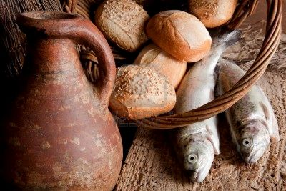
Seeking Jesus Study Series
ORDER FROM CHAOS
Living for Jesus in a troubled world
Notes:
Last week, we talked about being smarter than our enemies and standing up against evil without starting a war. No more ‘an eye for an eye,’ but stopping our enemies from taking advantage of us as believers. From that, you might think the best thing we could do is start a commune to escape the world; nothing could be further from the truth. Jesus does not want that. The world may view us as its enemy, but we must view the world the way Jesus did. He told us to pray for our enemies. We are to take his message of love and forgiveness into the world. Now, we are not to be foolish and think everyone will welcome the message, but we must not be afraid. We as believers can make a difference. This brings me to this morning and our approach to life and those around us.
So you think you have problems, and you think Jesus does not understand. But I contend Jesus is the one to go to for help in dealing with problems. Chaos swirled around him, and we can learn a lot about how to handle it by looking at how he handled it.
He must listen to the father for directions. FAITH
He must deal with the death of his cousin, John the Baptist. Family
He must deal with a hungry crowd and cautious disciples. Finances
He must deal with panicky disciples in a sinking boat. Focus
He must face life one day at a time. FUTURE
But first, I want to show you a picture of the nation we live in.

Slide 2
Biblical World View
A BWV is held by just 4% of all Americans^
  ABSOLUTE moral truth
  Bible is totally accurate in all principles it teaches
  Satan is a real being (evil exists)
  Salvation cannot be EARNED
  Jesus lived a SINLESS life
  God is all-knowing, all-powerful creator & is still involved in the world today.
A BWV is held by just 37% of American Pastors
WA is listed as 51% Christian, 10% other, and 38% unaffiliated, or 96% have a non-biblical worldview of life. In most cases, self-guiding on their feelings.
20% attend church weekly, while 60% never attend.
Notes:
^ This is expected to drop to 2% in the next 15 years.
http://www.barna.org/barna-update/article/5-barna-update/133-only-half-of-protestant-pastors-have-a-biblical-worldview Accessed April 20, 2013
I want to reaffirm something for you this morning. Just to make sure you know where I am coming from.
a “biblical worldview” was defined as believing that
absolute moral truth exists;
the Bible is totally accurate in all of the principles it teaches;
Satan is considered to be a real being or force, not merely symbolic;
a person cannot earn their way into Heaven by trying to be good or do good works;
Jesus Christ lived a sinless life on earth;
and God is the all-knowing, all-powerful creator of the world who still rules the universe today.
In the research, anyone who held all of those beliefs was said to have a biblical worldview.
http://www.barna.org/barna-update/article/21-transformation/252-barna-survey-examines-changes-in-worldview-among-christians-over-the-past-13-years Accessed April 20, 2013
“Barna reported in 2013 that only half of the country’s Protestant pastors - 51% - have a biblical worldview.” http://www.barna.org/barna-update/article/5-barna-update/133-only-half-of-protestant-pastors-have-a-biblical-worldview Accessed April 20, 2013
“A worldview serves as a person’s decision-making filter, enabling them to make sense of the complex and huge amount of information, experiences, relationships and opportunities they face in life.” http://www.barna.org/barna-update/article/21-transformation/252-barna-survey-examines-changes-in-worldview-among-christians-over-the-past-13-years Accessed April 20, 2013
This is a key to understanding the rapid moral change that is taking place in the nation. Without a foundation they are ready to accept a new moral code.
This is also a key to understanding why you may be so far outside of the mainstream of what is happening. This is also a key to understanding my preaching and teaching. I don’t use scripture because it feels good. I use it because it is good. It is absolute moral truth. If it comes down to what the world is saying and what the Word of God is saying you have to have made a choice. A BWV or a Secular Humanist World View or a postmodern world view that has not absolutes and is based on feelings. You know those things that swing in every direction.
Applying scripture to your life is a vital part of the Christian experience.
Knowing this, let’s look at the scriptures for guidance for our lives in this very difficult world.
Illustration:
In the early 20th century, a successful American shoe company was facing a sharp decline in sales. Concerned about the drop, the management held a meeting to discuss possible solutions. During the discussion, a new strategy emerged to explore international markets and expand the business.
The Sales Director decided to send two of the company’s best salesmen to Africa to assess the potential for selling shoes. Each salesman was assigned a different country so they could provide independent evaluations of the market.
Both men set off by boat, eager to begin their surveys. After a month, the first salesman completed his observations and called his Sales Director. Sounding discouraged, he reported:
“Boss, I have bad news. I have visited several cities, and no one here wears shoes. There is absolutely no market for us. We will not be able to sell a single pair.”
A few days later, the second salesman called back. His voice was filled with excitement as he shared his findings:
“Boss, I have great news. This is an incredible opportunity. No one here wears shoes, and there are no other shoe sellers in sight. The market is wide open. All we need to do is educate people on the benefits of wearing shoes, and we can sell thousands of pairs.”
We have the good news. We just need to help others see the benefits of accepting Jesus as their savior and lo

Slide 3
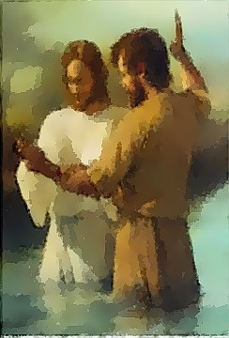

John the Baptist
^{Mark 6.17-20}
For Herod had sent soldiers to arrest and imprison John as a favor to Herodias. She had been his brother Philip's wife, but Herod had married her. John had been telling Herod, "It is against God's law for you to marry your brother's wife."

Slide 4
John the Baptist
^{Mark 6.17-20}
So Herodias bore a grudge against John and wanted to kill him. But without Herod's approval she was powerless, for Herod respected John; and knowing that he was a good and holy man, he protected him. Herod was greatly disturbed whenever he talked with John, but even so, he liked to listen to him.

Slide 5
FAMILY
John the Baptist
BAD things can and do happen to GOOD people.
Taking a STAND for truth is not a guarantee of earthly acceptance.
Things do not always turn out the way we WANT, but they are part of God’s plan.
Notes:
John's disciples came for his body and buried it. Then they went and told Jesus what had happened. Matthew 14.12
I have done my share of death notifications. I have been present as people breathed their last and passed from this world to the next. But the most difficult time is when someone you know and love, a family member dies and you get the death notification.
Now sometimes preaching truth is not any fun. There are a lot of preachers who will sugar coat everything so that people will want to come to their church. They only go to church to feel good. If you are one of those people you have chosen the wrong church on the wrong Sunday. I want you to feel good, but that is not necessarily my job.
Bad things can and do happen to good people.
Jesus warned us what it would be like for a believer in this world. “I am sending you out as sheep among wolves. So be as shrewd as snakes and harmless as doves.” ^{Matthew 10.16} You have to be smarter than the wolf or you will be his next meal. Christians must be smarter and shrewder than their enemies.
Taking a stand for truth is not a guarantee of earthly acceptance.
"Anyone who accepts your message is also accepting me. And anyone who rejects you is rejecting me. And anyone who rejects me is rejecting God, who sent me.“ ^{Luke 10.16} People will reject you if you are taking a stand for truth. Especially when it goes against their lifestyle and perceived happiness.
Things do not always turn out the way we want but they are part of God’s plan.
“We know that God causes everything to work together for the good of those who love God and are called according to his purpose for them.” ^{Romans 8.28} We have to be careful here it does not say God causes everything to happen, it says God causes what happens to work for his divine purposes and for his people. That does not mean we will like everything that happens. This may be hard but it is not really about us it is about Jesus and his kingdom.
2 Corinthians 1.3-5 Blessed be the God and Father of our Lord Jesus Christ, the Father of compassion and the God of all comfort, who comforts us in all our troubles, so that we can comfort those in any trouble with the comfort we ourselves have received from God. For just as the sufferings of Christ overflow to us, so also through Christ our comfort overflows.

Slide 6
FAMILY
John the Baptist
We are called on by Jesus to help HURTING people in DIFFICULT times.
2 Corinthians 1.3-5
Blessed be the God and Father of our Lord Jesus Christ, the Father of compassion and the God of all COMFORT, who COMFORTS us in all our troubles, so that we can COMFORT those in any trouble with the COMFORT we ourselves have received from God. For just as the sufferings of Christ overflow to us, so also through Christ our COMFORT overflows.
Notes:
2 Corinthians 1.3-5 Blessed be the God and Father of our Lord Jesus Christ, the Father of compassion and the God of all comfort, who comforts us in all our troubles, so that we can comfort those in any trouble with the comfort we ourselves have received from God. For just as the sufferings of Christ overflow to us, so also through Christ our comfort overflows.

Slide 7
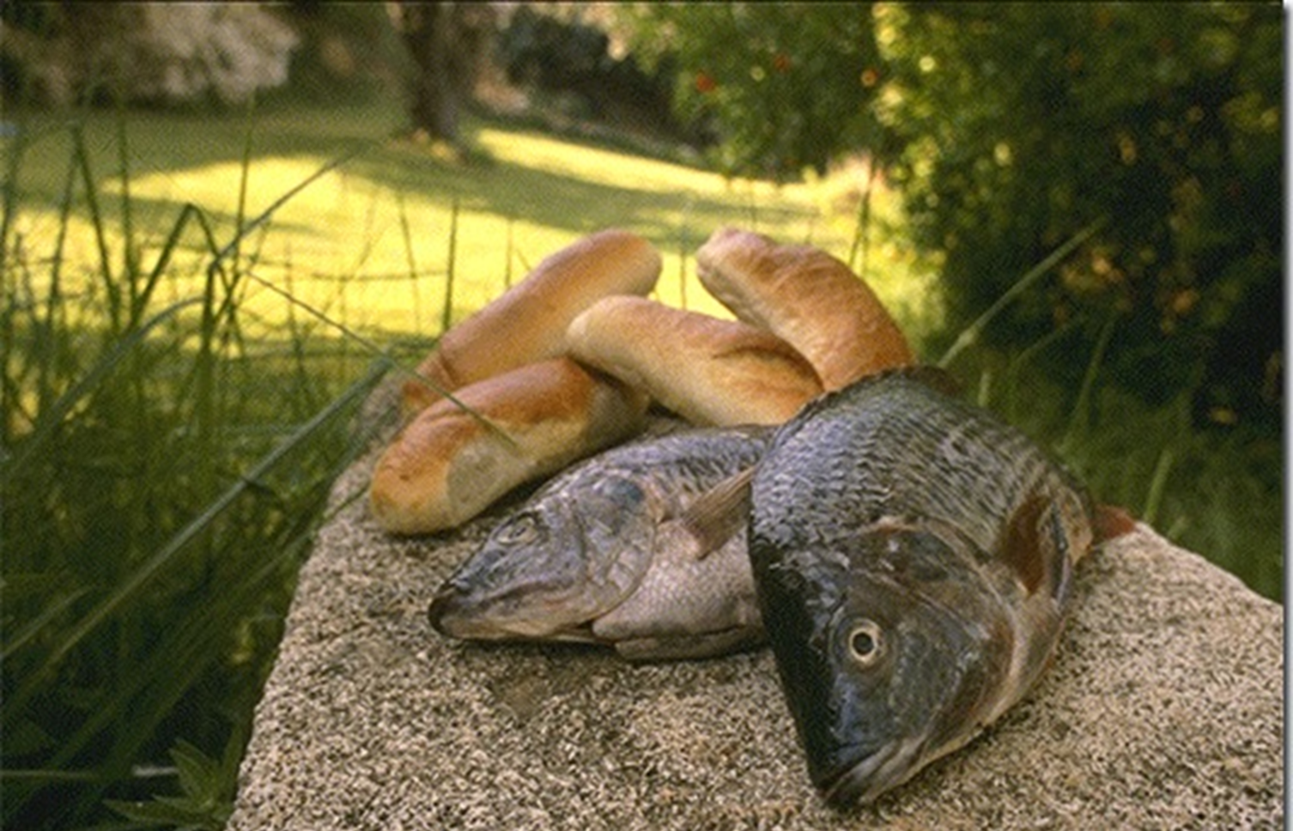
Feeding five thousand + Luke 9.13-17
But Jesus said, "You feed them."
"But we have only five loaves of bread and two fish," they answered. "Or are you expecting us to go and buy enough food for this whole crowd?" For there were about 5,000 men there.
Notes:
Organization is biblical and needed
Using what you have is the place to start

Slide 8
Feeding five thousand + Luke 9.13-17
Jesus replied, "Tell them to sit down in groups of about fifty each." So the people all sat down. Jesus took the five loaves and two fish, looked up toward heaven, and blessed them. Then, breaking the loaves into pieces, he kept giving the bread and fish to the disciples so they could distribute it to the people. They all ate as much as they wanted, and afterward, the disciples picked up twelve baskets of leftovers!
Notes:
Organization is biblical and needed
Using what you have is the place to start

Slide 9
FINANCES
Feeding five thousand + Luke 9.13-17
FACE your problems before they get any bigger.
ORGANIZE to deal with the situation you face!
  Turn your challenges into manageable-sized portions
USE what you have!
  Don’t focus on the lack of resources
  What is that in your hand?
TRUST, ‘GOD IS YOUR SOURCE!’
  “God is the one who provides seed for the farmer and then bread to eat.” ^{2 Corinthians 9.10}
  “Now, a person who is put in charge as a manager must be faithful.” ^{1 Corinthians 4.2}
Notes:
Organize to deal with the situation you face: Turn your challenges into manageable size portions.
5,000 becomes 100 small groups that can be dealt with one at a time.
Use what you have: People often focus on what they don’t have instead. The disciples wanted to know if they were to go and buy food to feed the 5,000 plus there that day.
Then the LORD asked MOSES, "What is that in your hand? A shepherd's staff,“ ^{Exodus 4.2}
Turned into a snake to prove it’s value ^{4:3}
So Moses took his wife and sons, put them on a donkey, and headed back to the land of Egypt. In his hand he carried the staff of God. ^{4:20}
Brought hailstorm ^{9:23}
Brought locust ^{10:13}
Parted the sea ^{14:16}
Water from the rock ^{17:5}
Defeated the army of Amalek ^{17:11}
Struck the rock twice and lost his blessing as the leader of Israel (misused God’s blessing in Anger) ^{Numbers 20:11}
God is your source: As believers you work for God
“God is the one who provides seed for the farmer and then bread to eat.” 2 Corinthians 9.10
“Now, a person who is put in charge as a manager must be faithful.” 1 Corinthians 4.2

Slide 10
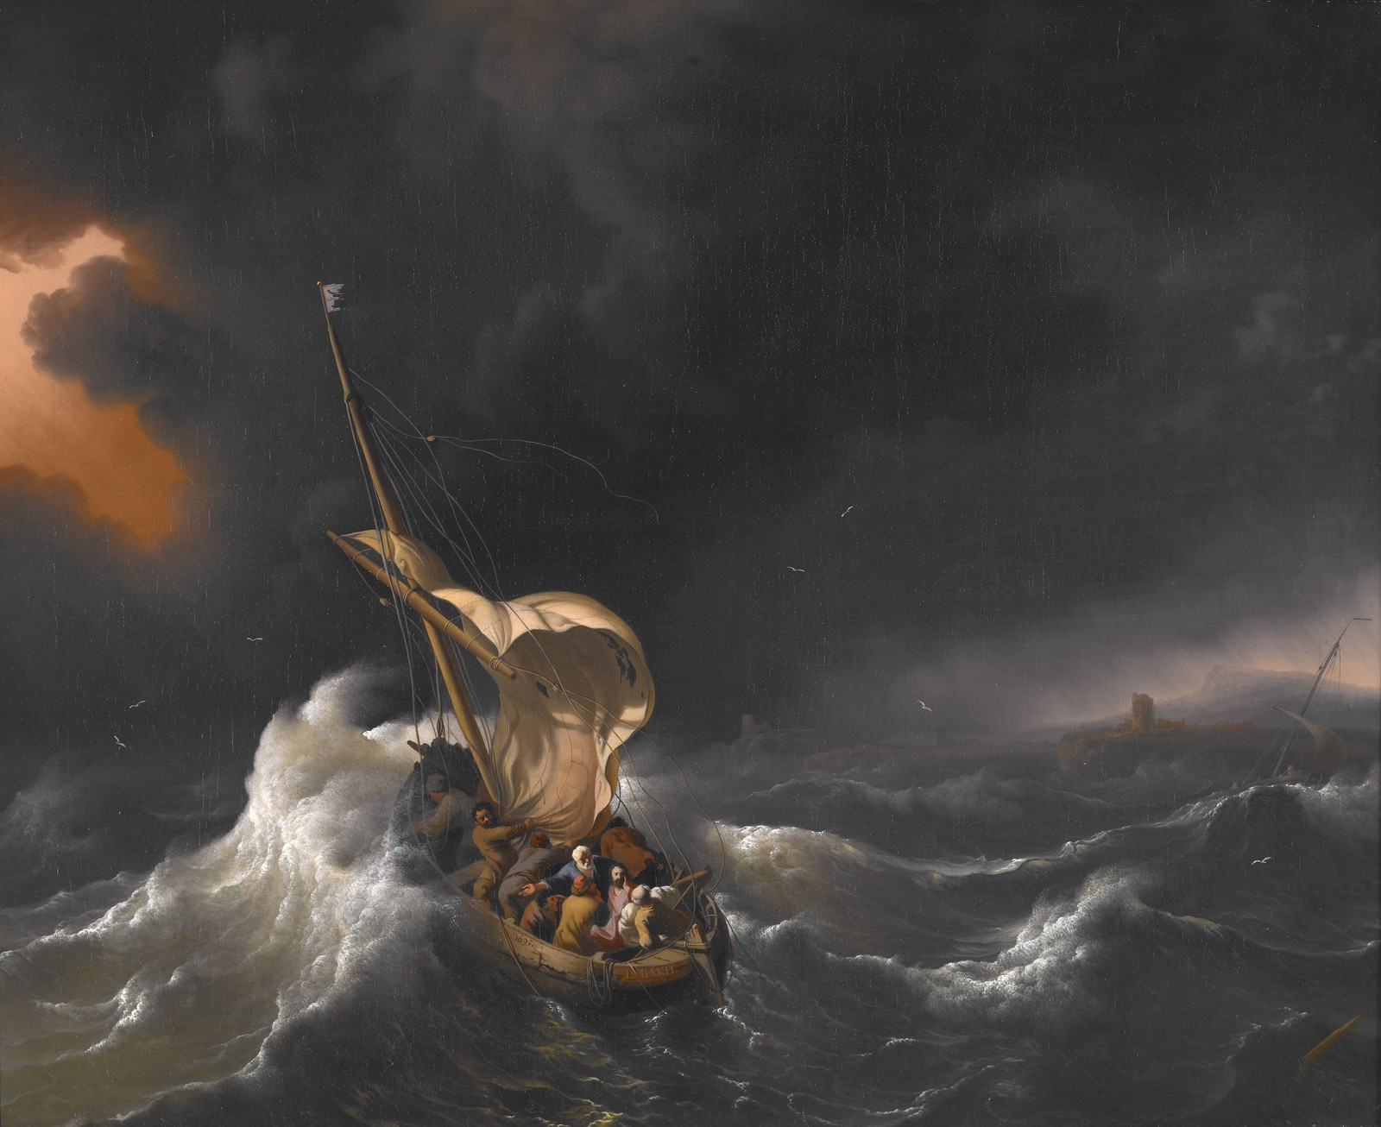
Calming the Storm Matthew 14.24-33
The disciples were in trouble far away from land, for a strong wind had risen, and they were fighting heavy waves. About three o'clock in the morning Jesus came toward them, walking on the water. When the disciples saw him walking on the water, they were terrified. In their fear, they cried out, "It's a ghost!"

Slide 11
Calming the Storm Matthew 14.24-33
But Jesus spoke to them at once. "Don't be afraid," he said. "Take courage. I am here!*"
Then Peter called to him, "Lord, if it's really you, tell me to come to you, walking on the water."
"Yes, come," Jesus said.

Slide 12
Calming the Storm Matthew 14.24-33
So Peter went over the side of the boat and walked on the water toward Jesus. But when he saw the strong wind and the waves, he was terrified and began to sink. "Save me, Lord!" he shouted.

Slide 13
Calming the Storm Matthew 14.24-33
Jesus immediately reached out and grabbed him. "You have so little faith," Jesus said. "Why did you doubt me?"
When they climbed back into the boat, the wind stopped. Then the disciples worshiped him. "You really are the Son of God!" they exclaimed.

Slide 14
FOCUS
Calming the Storm
People of FAITH WALK on water in storms to help those who are SINKING and without hope.
People who SINK do so because they are FOCUSED on the world and are not able to believe on their own.
Our faith helps CALM the storms in the lives of those who are searching for help in the most difficult times.
Notes:
Jesus insisted that his disciples get back into the boat and head across the lake to Bethsaida, while he sent the people home. After telling everyone good-bye, he went up into the hills by himself to pray. Mark 6.45-46
People call out in times of crisis, but few stay for the long haul. Right after 9/11 church attendance shot up dramatically. Some churches were full of worried people within hours after the terrorist attack. But ten years later almost everyone was gone and attendance returned to pre 9/11 numbers. “According to the survey by the Barna Research Group, although churches reported increased attendance in the aftermath of the attacks, church attendance is now back to pre-attack levels. In addition, the survey showed that Americans are less likely to believe in absolute good or evil.” http://listserv.virtueonline.org/pipermail/virtueonline_listserv.virtueonline.org/2001-December/002984.html Accessed April 20, 2013
This means the spike was short lived and the evil of 9/11 made people more pessimistic about the world they live in and more pessimistic about God.
This spiritual cycle seems to discourage many but we must not give up. God has seen it before and he understands. One thing I see today is most of the country has turned into frogs in the kettle. They are adjusting to sin and not even aware of how bad it is getting. There is a YouTube video about this but I could not show it without upsetting someone. TELL WHAT HAPPENS.

Slide 15
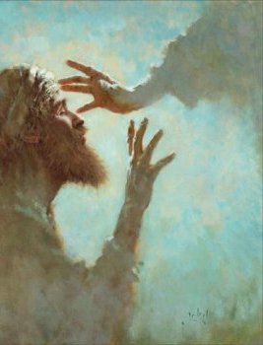
More Chaos Mark 6.53-56
After they had crossed the lake, they landed at Gennesaret. They brought the boat to shore and climbed out. The people recognized Jesus at once, and they ran throughout the whole area, carrying sick people on mats to wherever they heard he was. Wherever he went–in villages, cities, or the countryside–they brought the sick out to the marketplaces. They begged him to let the sick touch at least the fringe of his robe, and all who touched him were healed.

Slide 16
FUTURE .
Chaos or Opportunity Mark 6.53-56
They landed at Gennesaret:
  LIFE GOES ON: You have to choose to keep on for God or to drop out from the pressure.
The people recognized Jesus at once:
  Success in faith matters is what OPENS DOORS to minister to others.
They begged him:
  When people are in TROUBLE is when they are willing to give God a try. That’s our OPPORTUNITY to minister in Jesus’ name.

Slide 17

Finding Order in a World Full of Chaos
FAITH: Your Biblical Worldview is what matters. Choose where you stand. Matthew 10.40 , John 4.34
FAMILY: You are to provide COMFORT as Jesus has COMFORTED you. Galatians 6.10 “Especially to the Family of FAITH.”
FINANCES: Face your problems. Organize for success. Use what you have, Trust in God. 2 Corinthians 9.10
FOCUS: Is what occurs when storms come. If you focus on the world, you will sink. Focus on Jesus and walk on water.
FUTURE: Life goes on, and there are always opportunities to serve Him, and challenges we will face.
Notes:
Matthew 10.40
He who receives you receives Me, and he who receives Me receives the One who sent Me.
John 4.34 (NOTE: In the book of John, Jesus repeats 34 times that he was sent by the Father to do the Father’s will.)
“My food is to do the will of Him who sent Me and to finish His work.
Galatians 6.10
Therefore, as we have opportunity, let us do good to everyone, and especially to the family of faith.
2 Corinthians 9.10
Now He who supplies seed to the sower and bread for food will supply and multiply your store of seed and will increase the harvest of your righteousness.

